Slide 1
STATS AND ML FUNDAMENTALS

Slide 2
LECTURE 1

Slide 3
STATISTICS
Discipline/Field of Study:
Statistics (discipline): Math dealing with data—collecting, analyzing, interpreting.
Descriptive
inferential stats.
Data Summary or Measurements:
Statistics (data): Numerical measures—mean, median, standard deviation. Summarize and understand data.

Slide 4
Descriptive VS. Inferential
Descriptive Statistics:
Purpose: Summarize and describe main features of a dataset.
Examples: Mean, median, mode, standard deviation.
Application: Provides insights into the central tendency, variability, and distribution of data.
Usage: Useful for organizing and simplifying large amounts of data for easy interpretation.
Inferential Statistics:
Purpose: Make predictions or inferences about a population based on a sample.
Examples: Hypothesis testing, regression analysis.
Application: Extends findings from a sample to a larger population.
Usage: Allows researchers to draw conclusions and make predictions beyond the observed data.

Slide 5
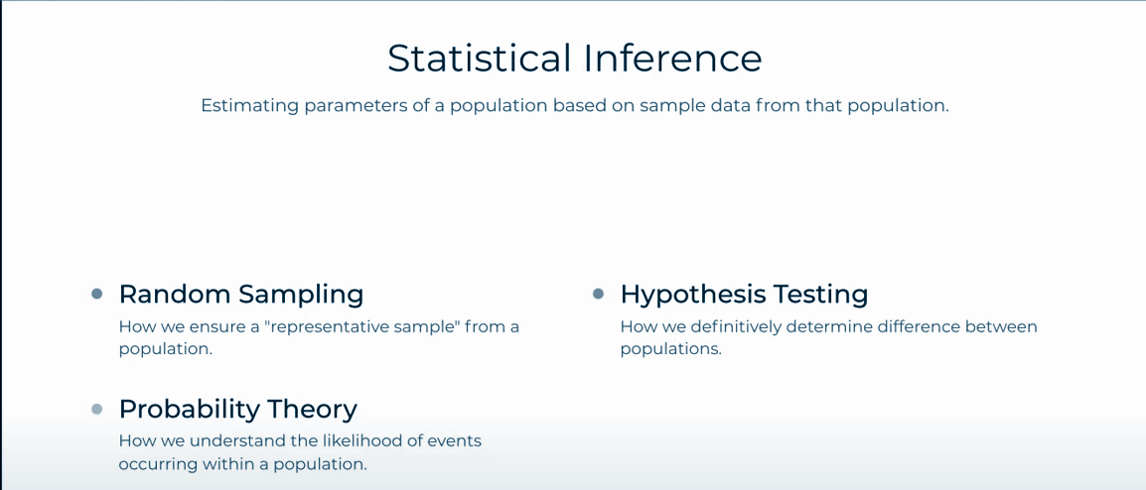

Slide 6
Statistical Inference
Statistical inference is the process of using data from a random sample to make conclusions or predictions about a larger population. It relies heavily on probability theory to ensure that conclusions are valid and quantifiable
Random Sampling
Choosing a sample in a fair way, where everyone has an equal chance of being picked.
Helps avoid bias and ensures the sample represents the bigger group.
Probability
The math behind how likely something is to happen.
Helps us measure how confident we are in our conclusions.
Hypothesis Testing
A way to test ideas or claims using data.
For example: “Is the new product better than the old one?”
We use data to check if the claim holds up — or if it’s likely just due to chance.
In a nutshell: Statistical inference is like using a small piece of the puzzle (your sample) to understand the big picture — using fair selection, chance, and data testing.

Slide 7
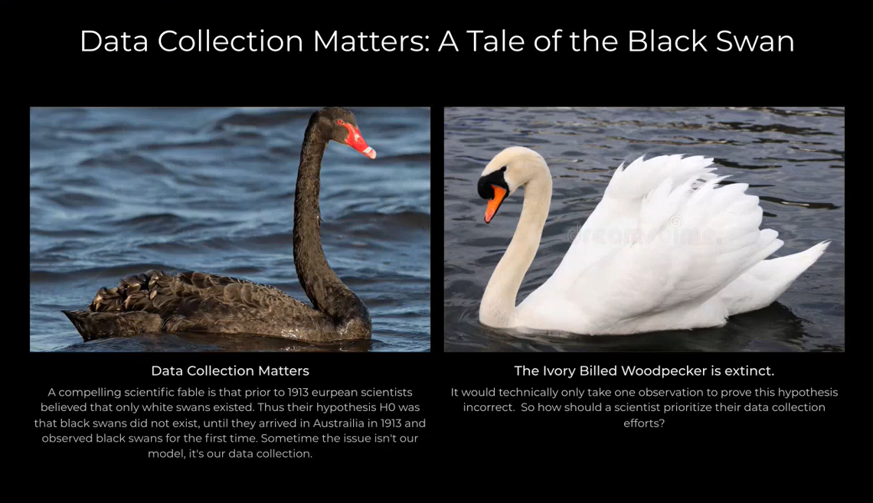

Slide 8
Back to Colab
https://colab.research.google.com/drive/1cgJol0nWEkYzwzYFyzqyh7xg7fm-BrT3

Slide 9
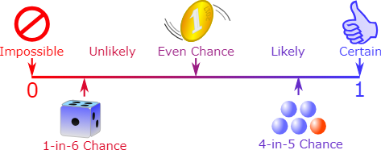
BASICS OF PROBABILITY
Probability is the numerical chance that something will happen; it tells us how likely it is that some event will occur.
2 main terms:
Event
Raining tomorrow.
Rolling an even number on a six-sided die.
Outcome
rain or no rain.
rolling a 2, 4, or 6
Image from: https://www.askiitians.com/iit-jee-algebra/probability/

Slide 10
Question
What is the difference between the terms: Probability and Possibility.
Never confuse these terms as a statistician/data scientist.

Slide 11
Possibility indicates whether an event can happen, while probability quantifies how likely that event is to occur.
Please note this

Slide 12
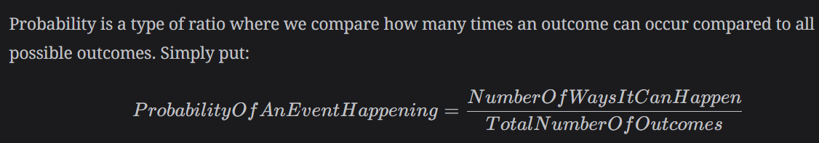
FORMULA

Slide 13

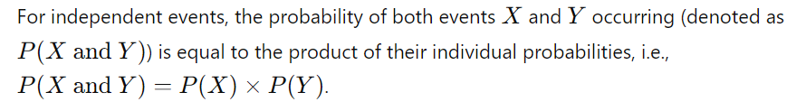
EXAMPLE 1: Independent Event
Independent events are two or more events where the occurrence of one event does not affect the occurrence of the other(s).
P(X and Y) = P(X) * P(Y)

Slide 14
EXAMPLE 1: Independent Event
What is the probability of getting three 6s if we have 3 dice?
What is the probability of getting a 6 in one die?
P(X and Y) = P(X) * P(Y)

Slide 15
EXAMPLE 1: Independent Event
What is the probability of getting three 6s if we have 3 dice?
What is the probability of getting a 6 in one die?
→ 1/6
P(X and Y) = P(X) * P(Y)

Slide 16
EXAMPLE 1: Independent Event
What is the probability of getting three 6s if we have 3 dice?
What is the probability of getting a 6 in one die?
→ 1/6
What is the probability of getting 3 6s?
P(X and Y) = P(X) * P(Y)

Slide 17
EXAMPLE 1: Independent Event
What is the probability of getting three 6s if we have 3 dice?
What is the probability of getting a 6 in one die?
→ 1/6
What is the probability of getting 3 6s?
→ 1/6 * 1/6 * 1/6
P(X and Y) = P(X) * P(Y)

Slide 18
EXAMPLE 1: Independent Event
What is the probability of getting three 6s if we have 3 dice?
What is the probability of getting a 6 in one die?
→ 1/6
What is the probability of getting 3 6s?
→ 1/6 * 1/6 * 1/6
Answer: 1/216
This probability, when expressed as a decimal, is approximately 0.0046. So, the probability of rolling three 6s on a fair six-sided die is approximately 0.0046 or 0.46%.
P(X and Y) = P(X) * P(Y)

Slide 19
LAB 7: Q1
You roll a fair six-sided die. What is the probability of rolling a 3 on the first roll and a 5 on the second roll? (Assume each roll is independent.)

Slide 20
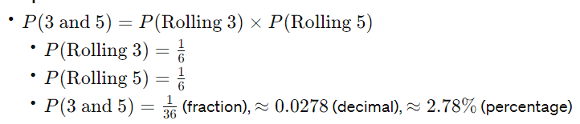

Slide 21
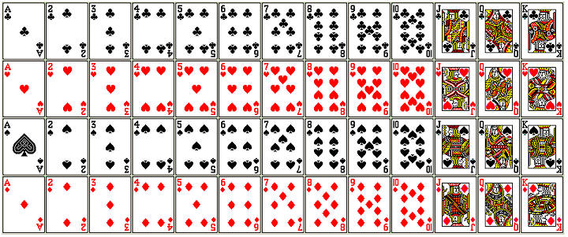
A deck of cards for reference

Slide 22
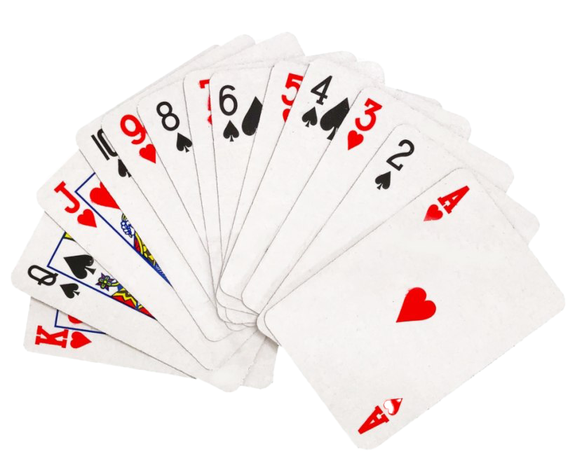
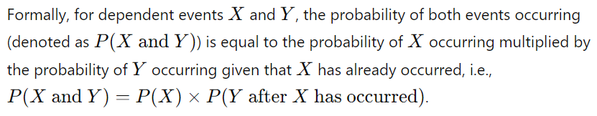
EXAMPLE 2: Dependent Events
Dependent events are events where the occurrence of one event affects the probability of the occurrence of another event.
P(X and Y) = P(X) * P(Y after X has occurred)

Slide 23
EXAMPLE 2: Dependent Events
What is the probability of choosing two red cards in a deck of cards?
Out of 52 cards, half is red, half is black.
P(X and Y) = P(X) * P(Y after X has occurred)

Slide 24
EXAMPLE 2: Dependent Events
What is the probability of choosing two red cards in a deck of cards?
Out of 52 cards, half is red, half is black.
→ P(red)= 26/52=1/2
P(X and Y) = P(X) * P(Y after X has occurred)

Slide 25
EXAMPLE 2: Dependent Events
What is the probability of choosing two red cards in a deck of cards?
Out of 52 cards, half is red, half is black.
→ P(red)= 26/52=1/2
Since we are then left with 51 cards,
P(X and Y) = P(X) * P(Y after X has occurred)

Slide 26
EXAMPLE 2: Dependent Events
What is the probability of choosing two red cards in a deck of cards?
Out of 52 cards, half is red, half is black.
→ P(red)= 26/52=1/2
Since we are then left with 51 cards,
→ P(2nd red)= 26/52 ∗ 25/51
P(X and Y) = P(X) * P(Y after X has occurred)

Slide 27
EXAMPLE 2: Dependent Events
What is the probability of choosing two red cards in a deck of cards?
Out of 52 cards, half is red, half is black.
→ P(red)= 26/52=1/2
Since we are then left with 51 cards,
→ P(2nd red)= 26/52 ∗ 25/51
Answer: 25/102
So, the probability of drawing a red card on the second draw is approximately
0.2451 or 24.51%
P(X and Y) = P(X) * P(Y after X has occurred)

Slide 28
LAB 7: Q2
You have a bag with six marbles: three red marbles and three blue marbles. If you draw a marble, record its color, and then do not put it back into the bag before drawing another marble. What is the probability of the following?
What is the probability of drawing a red marble on the first draw?
What is the probability of drawing a blue marble on the second draw after drawing a red marble on the first draw?
Calculate the probability of both events occurring (drawing a red marble on the first draw and a blue marble on the second draw).

Slide 29
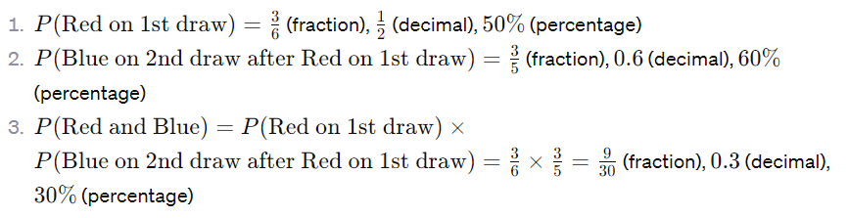

Slide 30


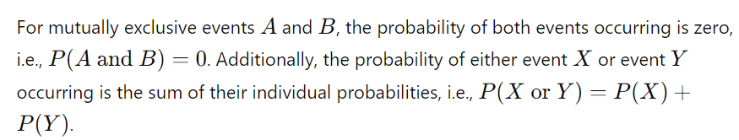
EXAMPLE 3: Mutually Exclusive Events (Can’t happen together)
Mutually exclusive events are events that cannot occur simultaneously.
P(A and B) = 0 and P(X or Y) = P(X) + P(Y)

Slide 31
EXAMPLE 3: Mutually Exclusive Events (Can’t happen together)
What is the probability of getting a King and a Queen from a deck of cards?
P(A and B) = 0 and P(X or Y) = P(X) + P(Y)

Slide 32
EXAMPLE 3: Mutually Exclusive Events (Can’t happen together)
What is the probability of getting a King and a Queen from a deck of cards?
Straight up, ZERO!
But we can do King OR Queen…
P(A and B) = 0 and P(X or Y) = P(X) + P(Y)

Slide 33
EXAMPLE 3: Mutually Exclusive Events (Can’t happen together)
What is the probability of getting a King OR a Queen from a deck of cards?
There are 52 cards with 4 suits (hearts, diamonds, clubs, and spades)
Each suit has 1 Queen and 1 King.
P(A and B) = 0 and P(X or Y) = P(X) + P(Y)

Slide 34
EXAMPLE 3: Mutually Exclusive Events (Can’t happen together)
What is the probability of getting a King OR a Queen from a deck of cards?
There are 52 cards with 4 suits (hearts, diamonds, clubs, and spades)
Each suit has 1 Queen and 1 King.
Hence, the probability of drawing a Queen is 4/52 or 1/13. Same for the King
Combining them,
→ 1/13 + 1/13 = 2/13
P(A and B) = 0 and P(X or Y) = P(X) + P(Y)

Slide 35
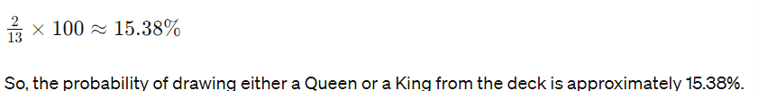
EXAMPLE 3: Mutually Exclusive Events (Can’t happen together)
What is the probability of getting a King OR a Queen from a deck of cards?
There are 52 cards with 4 suits (hearts, diamonds, clubs, and spades)
Each suit has 1 Queen and 1 King.
Hence, the probability of drawing a Queen is 4/52 or 1/13. Same for the King
Combining them,
→ 1/13 + 1/13 = 2/13
P(A and B) = 0 and P(X or Y) = P(X) + P(Y)

Slide 36
LAB 7: Q3
You flip a fair coin. What is the probability of getting heads or tails?

Slide 37
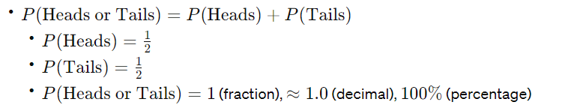

Slide 38
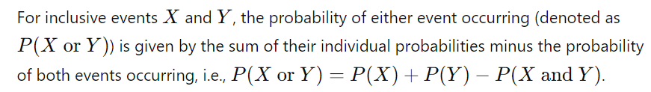
EXAMPLE 4: Inclusive Events (Can happen at the same time)
Inclusive events are events that can occur simultaneously.
P(X or Y) = P(X) + P(Y) − P(X and Y)

Slide 39
EXAMPLE 4: Inclusive Events (Can happen at the same time)
If you choose a card from a deck, what is the probability of getting a Queen or a Heart?
We can either get a Queen, a Heart, or the Queen of Hearts.
P(X or Y) = P(X) + P(Y) − P(X and Y)

Slide 40
EXAMPLE 4: Inclusive Events (Can happen at the same time)
If you choose a card from a deck, what is the probability of getting a Queen or a Heart?
We can either get a Queen, a Heart, or the Queen of Hearts.
P(X) = 4/ 52
P(Y) = 13/52
P(X or Y) = P(X) + P(Y) − P(X and Y)

Slide 41
EXAMPLE 4: Inclusive Events (Can happen at the same time)
If you choose a card from a deck, what is the probability of getting a Queen or a Heart?
We can either get a Queen, a Heart, or the Queen of Hearts.
P(X) = 4/ 52
P(Y) = 13/52
P(X and Y) = 1/52
P(X or Y) = P(X) + P(Y) − P(X and Y)

Slide 42
EXAMPLE 4: Inclusive Events (Can happen at the same time)
If you choose a card from a deck, what is the probability of getting a Queen or a Heart?
We can either get a Queen, a Heart, or the Queen of Hearts.
P(X) = 4/ 52
P(Y) = 13/52
P(X and Y) = 1/52
P(X or Y) = 4/ 52 + 13/52 - 1/52
P(X or Y) = P(X) + P(Y) − P(X and Y)

Slide 43
EXAMPLE 4: Inclusive Events (Can happen at the same time)
If you choose a card from a deck, what is the probability of getting a Queen or a Heart?
We can either get a Queen, a Heart, or the Queen of Hearts.
P(X) = 4/ 52
P(Y) = 13/52
P(X and Y) = 1/52
P(X or Y) = 4/ 52 + 13/52 - 1/52
Answer: 16/52 or 4/13
P(X or Y) = P(X) + P(Y) − P(X and Y)

Slide 44
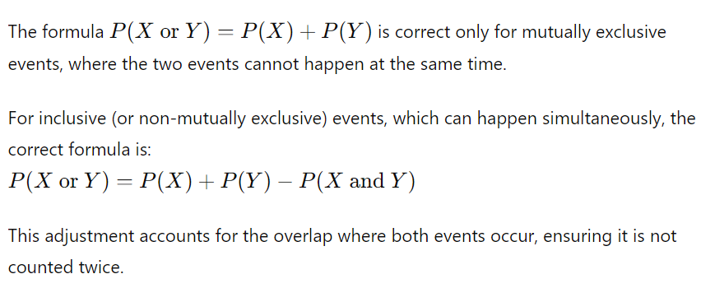
Please note this

Slide 45
LAB 7: Q4
In a deck of 52 cards, what is the probability of drawing either a spade or a face card (king, queen, or jack)?

Slide 46
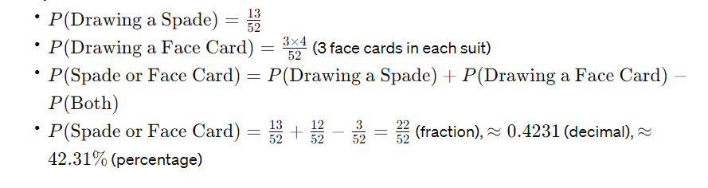

Slide 47
TO BE CONTINUED…

